Slide 1
HW 06 Customer Segmentation
BADS7105 – CRM Analytics and Intelligence
Watcharaphan Watcharanggurpipat​

Slide 2
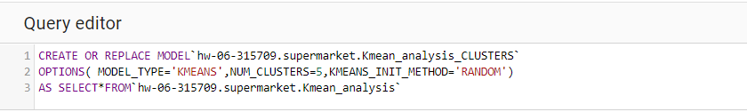
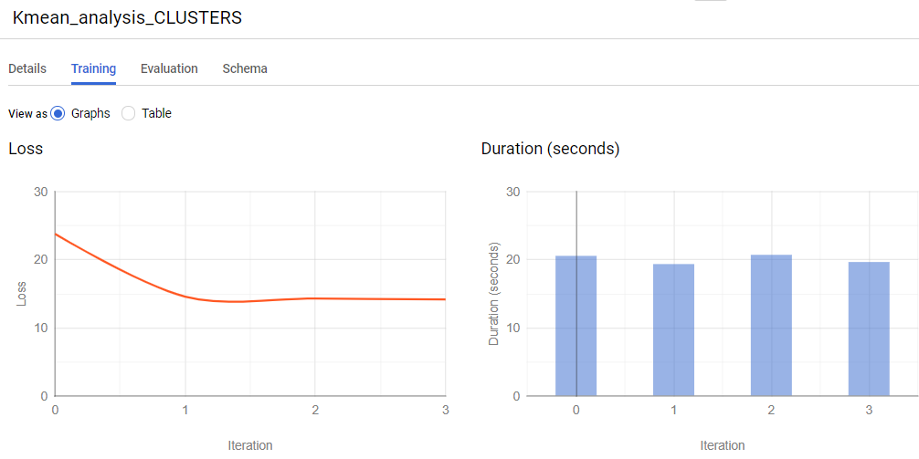
01
SQL Script running in Google Big Query
02
Training Result - Graph

Slide 3
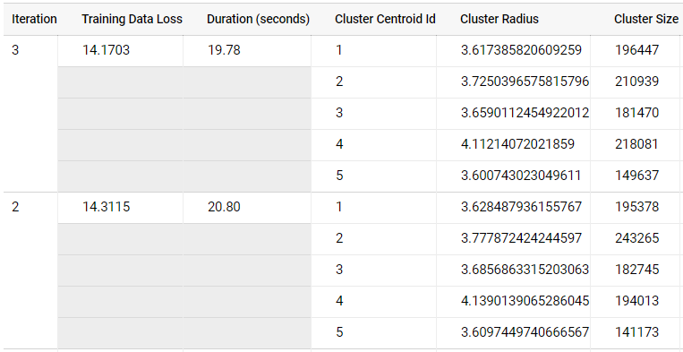
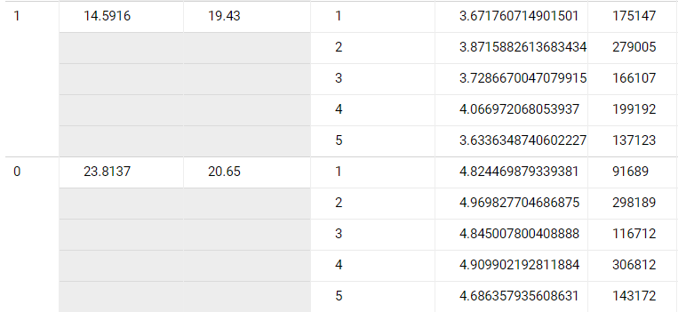
02
Training Result - Table

Slide 4
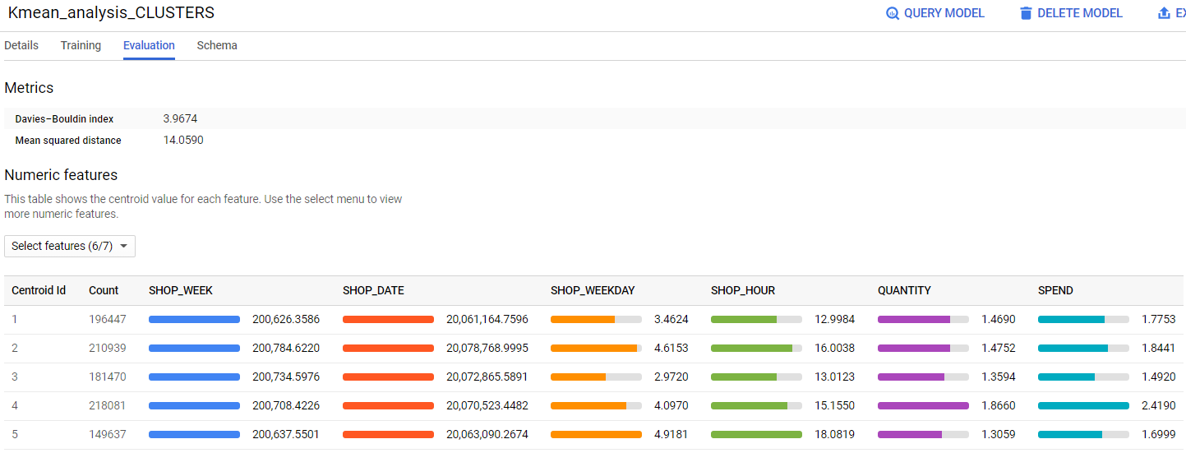
03
Evaluation

Slide 5
